Slide 1

The Curtain Company

Slide 2
Recapping Our Purpose
Platform where the client can sell collections of curtain samples.
Highlight client’s design recommendations to customers.
Connect customers to designer through consultation request after successful purchase of collection samples.

Slide 3
App Key Features

Slide 4
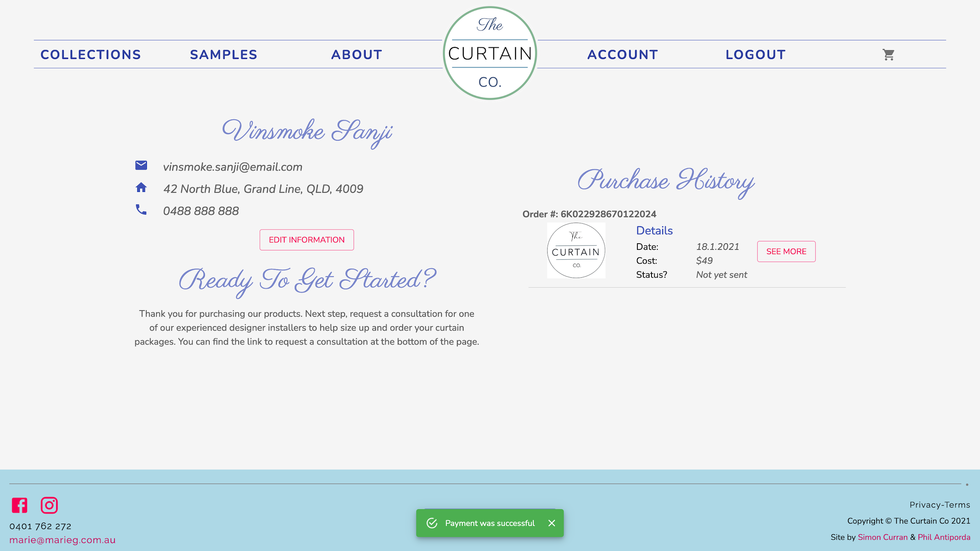
PayPal Integration - Success
- Redirects to Account Page, shows Order in Purchase History and shows success snackbar
1

Slide 5
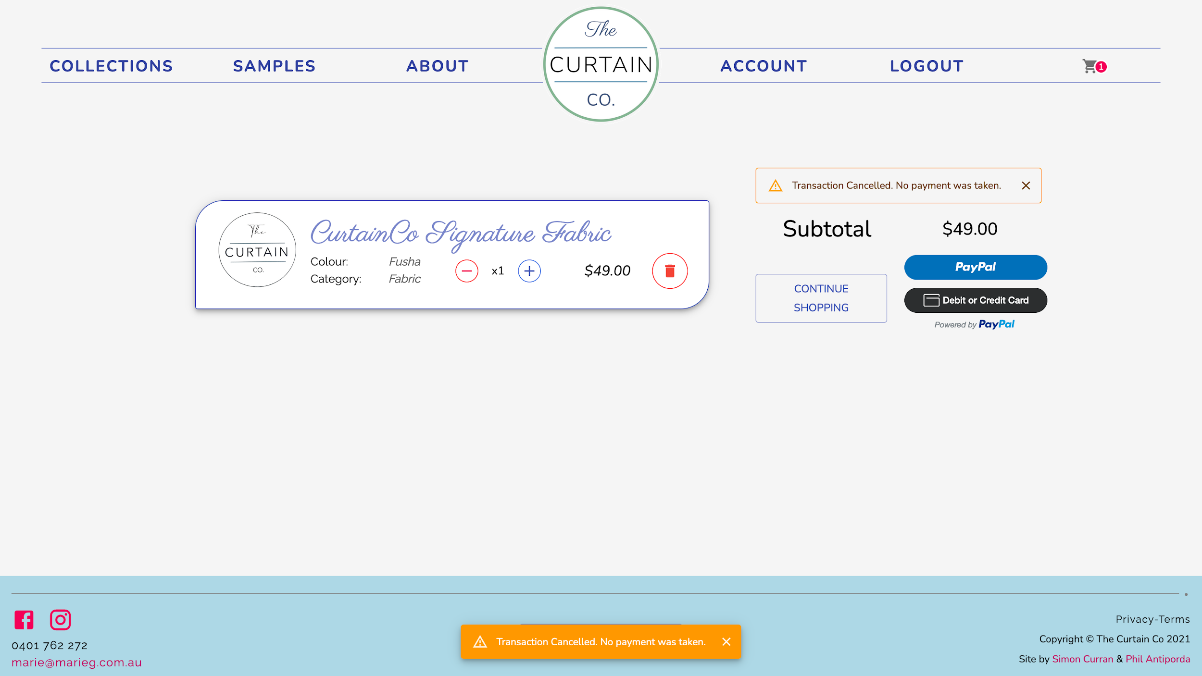
PayPal Integration - Cancellation
- Shows Warning Snackbar and persistent Warning Alert above Cart Total until refresh
1

Slide 6
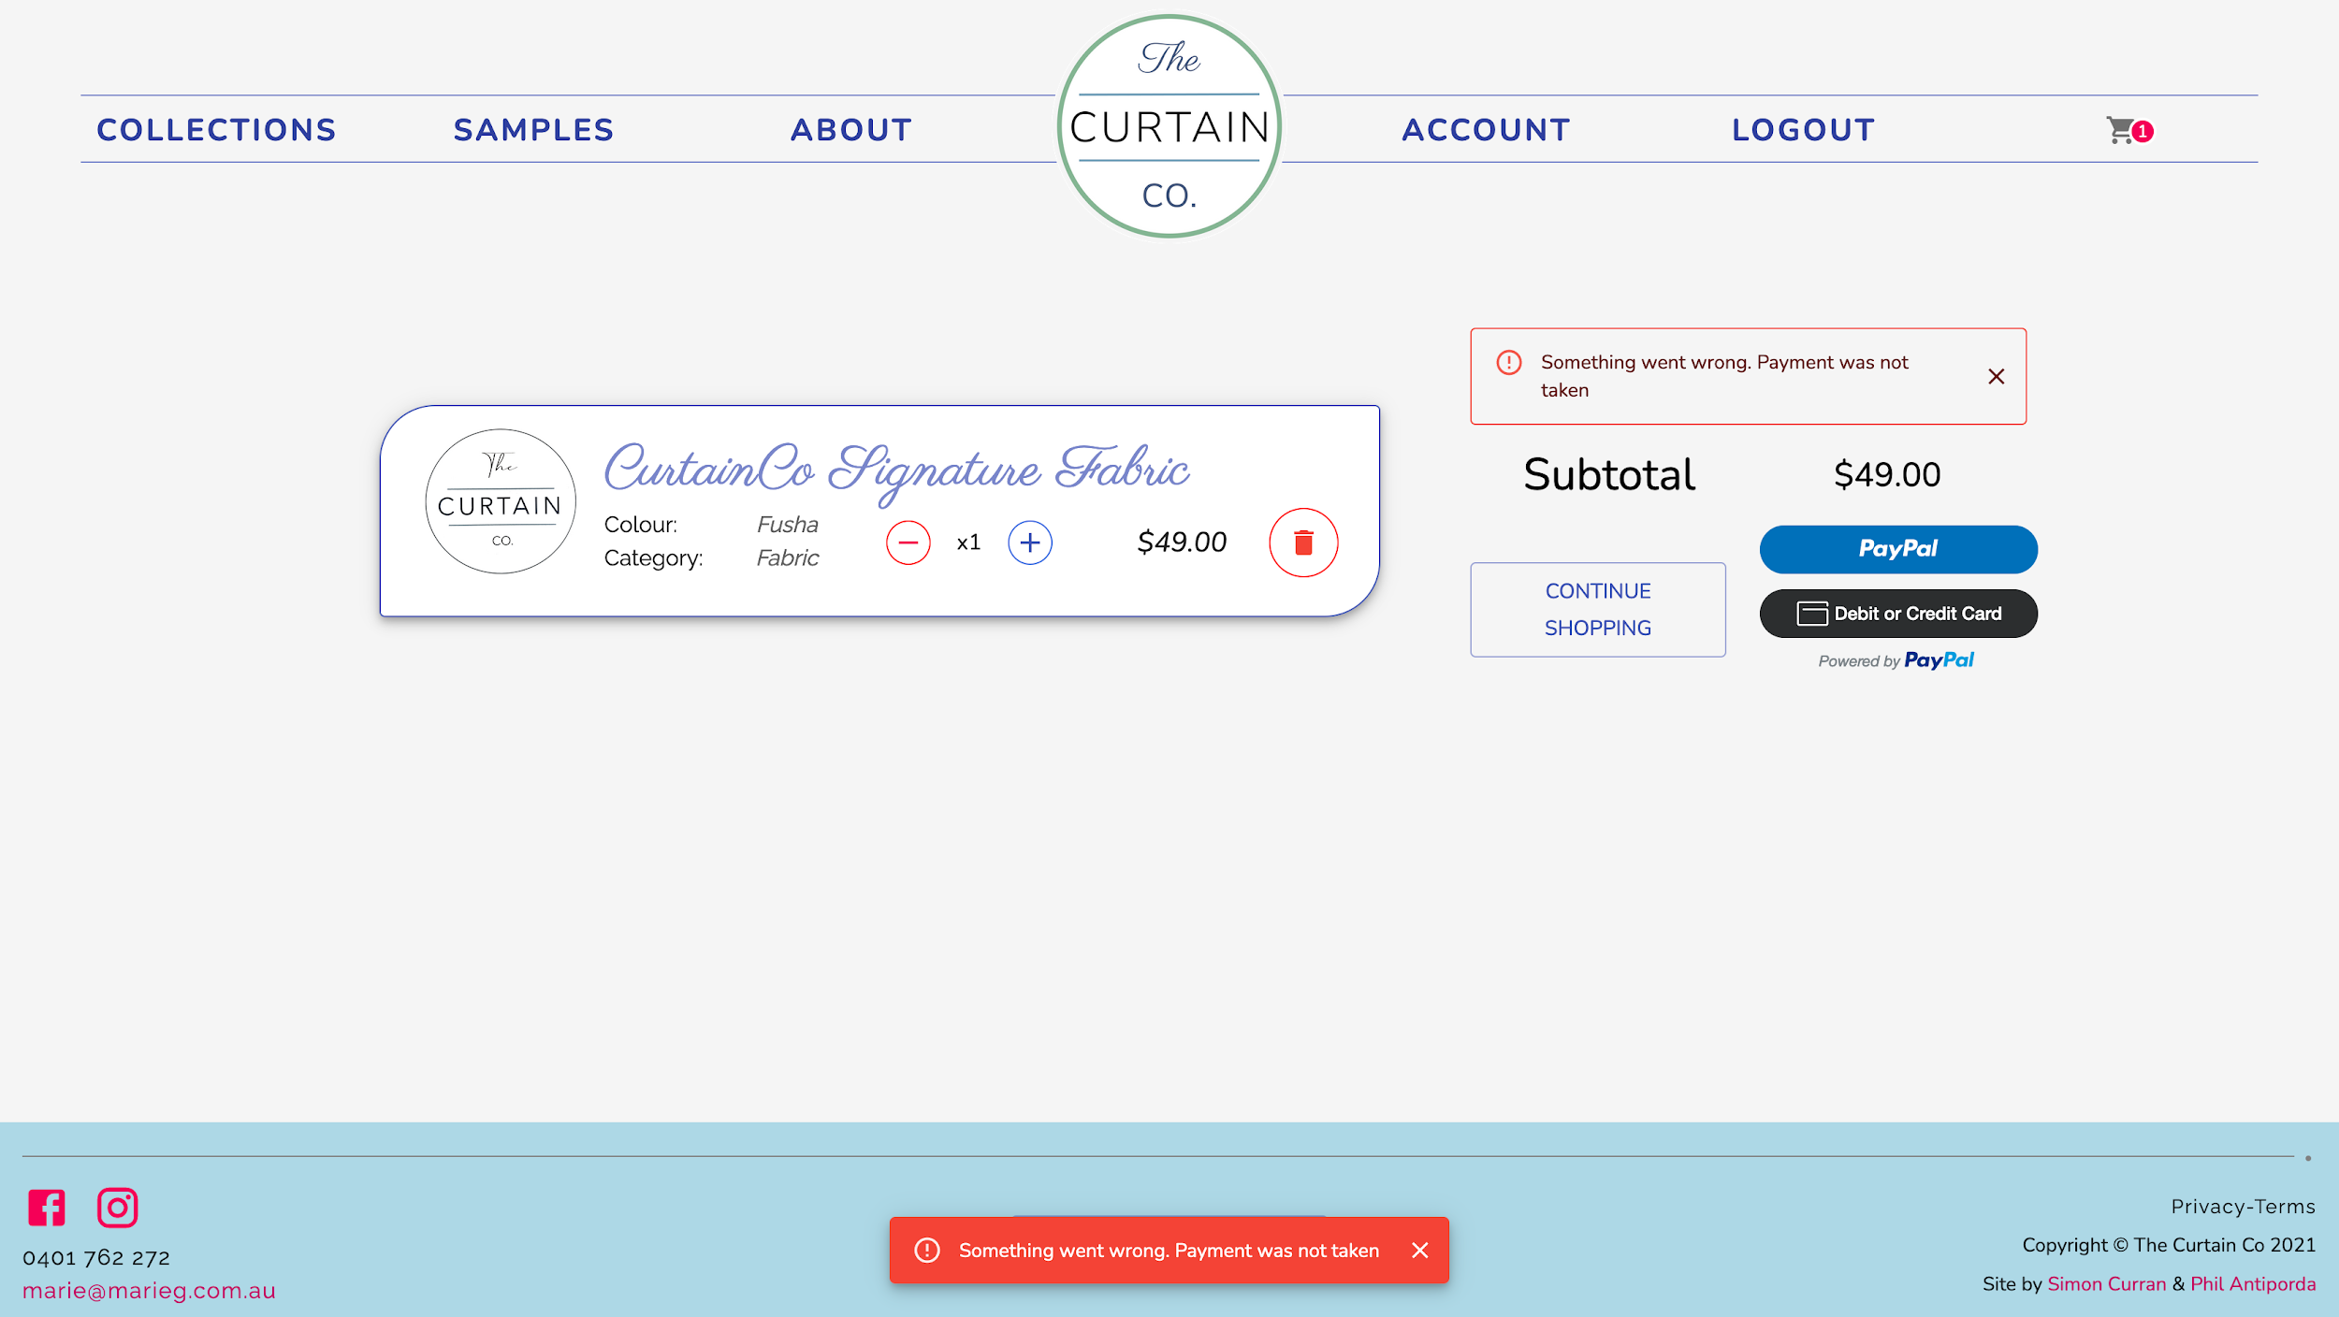
PayPal Integration - Error
- Shows Error Snackbar and persistent Error Alert above Cart Total until refresh
1

Slide 7
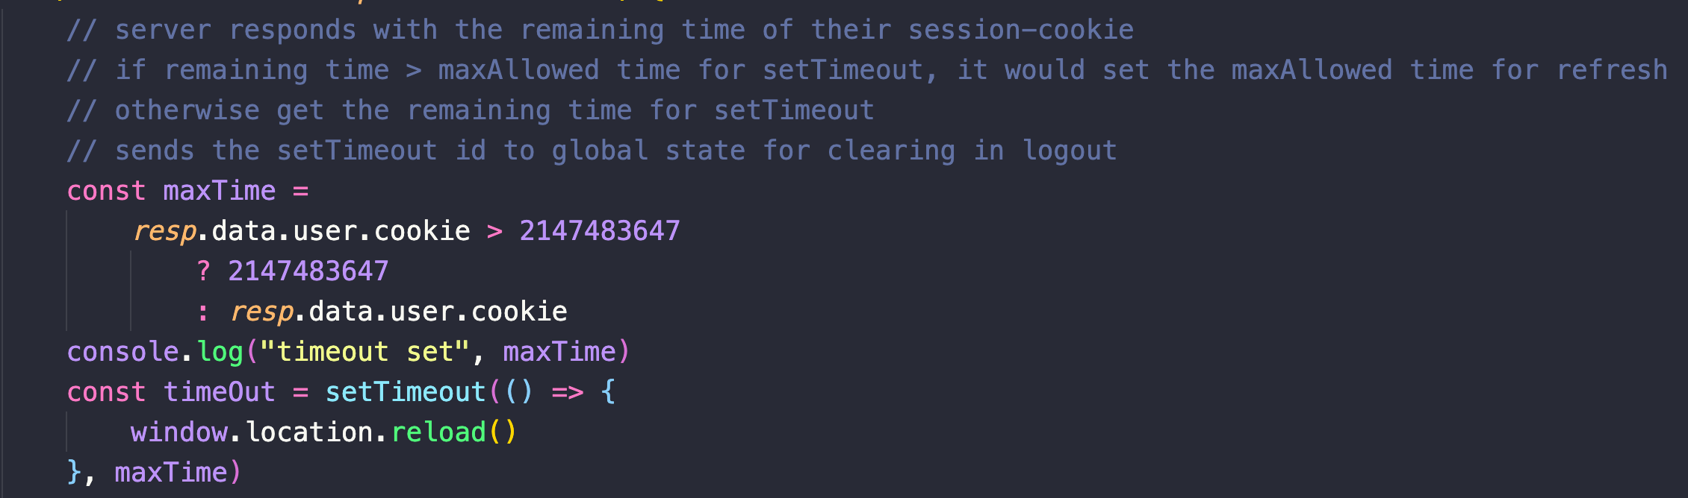
Reload on Session Expiry
2

Slide 8
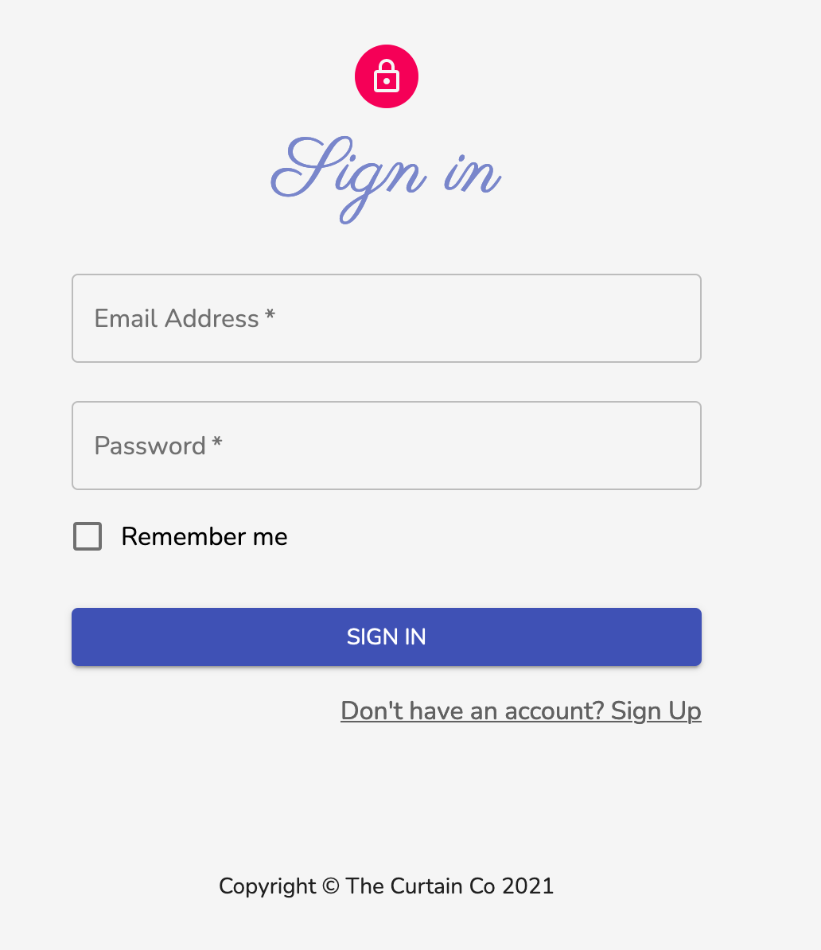
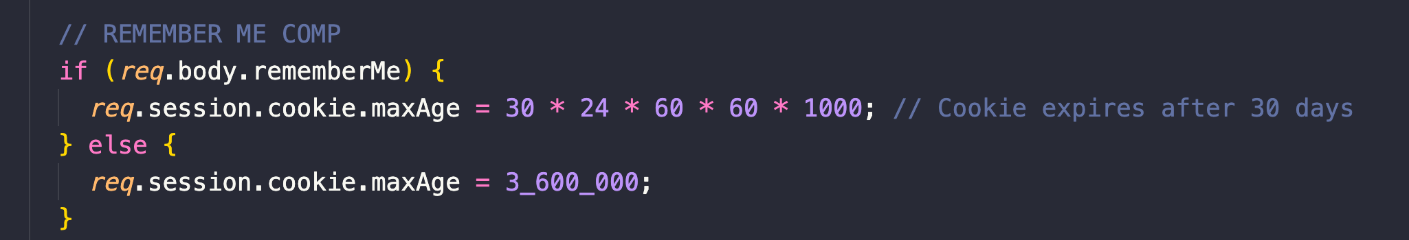
Remember Me Option
3

Slide 9
Tests
Implemented

Slide 10
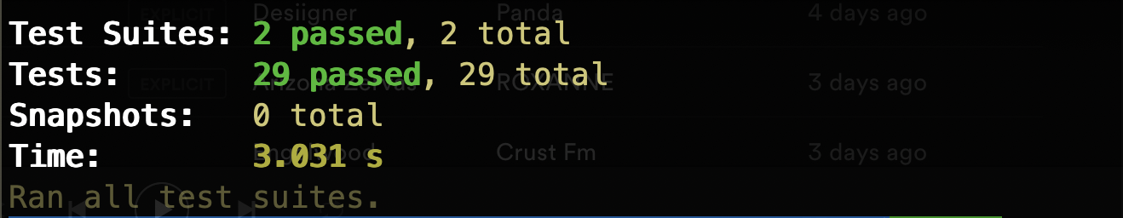
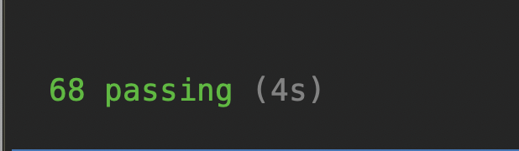
Testing Frameworks
Jest - Unit Testing for FE
Mocha-Chai - Integration Testing for BE

Slide 11
Production Tests

Slide 12
Roadblocks and Challenges

Slide 13
PayPal Integration
Browser’s Change in Policy
Roadblocks and Challenges
Implementation from initial usage of a package to refactoring to use CDN
Handling scenarios
Handling of session cookies in accordance to recent changes in browser’s policy.

Slide 14
Collaborating with the Client
Project Scoping and Deadlines
Roadblocks and Challenges
General scope of tasks associated with user stories.
Estimating time required to accomplish a feature or fix a bug.
Working around client’s timeframe and availability.

Slide 15
App Walkthrough

Slide 16

Thanks!
Any questions?
You can find us at:
@simo_sultan
https://github.com/SimoSultan
@PeelRasel
https://github.com/philrussel21

